Slide 1

Net Revenue Management
Case Study:
Myvizhi Praveen Kumar

Slide 2
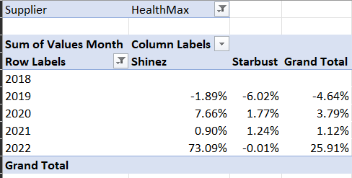
YOY Growth
Insights
In 2020, HealthMax grew by 4%. Shinez brand contributed to its success with its 7.7% YOY growth
In 2022, Shinez Contribution increased by 65%

Slide 3
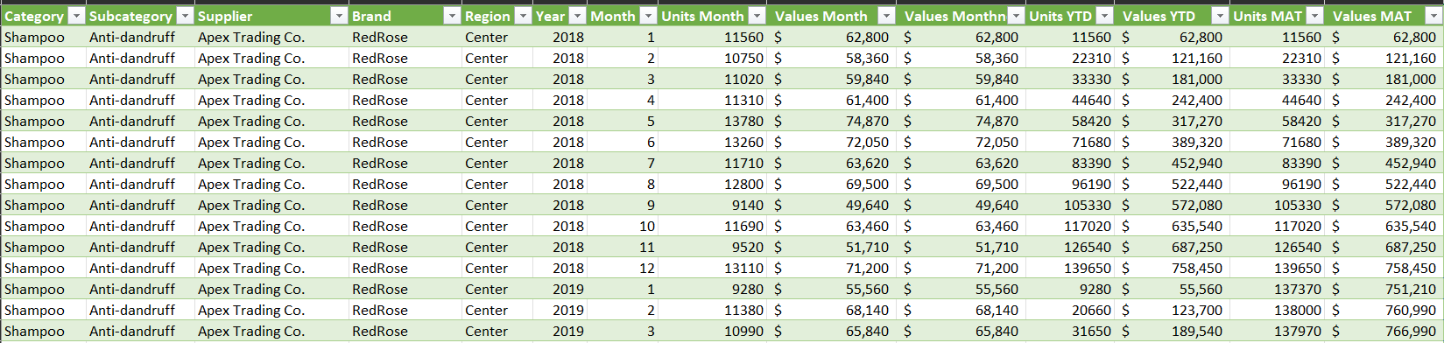
Sample data set after YTD and MAT calculation for unit sales and value sales

Slide 4
Health Max Market Share Analysis
Insights
Vitalize is the biggest competitor of Starbust
Shinez has a Market share growth of 6.17% and Starbust has a 4.11% growth from 2018 to 2023

Slide 5
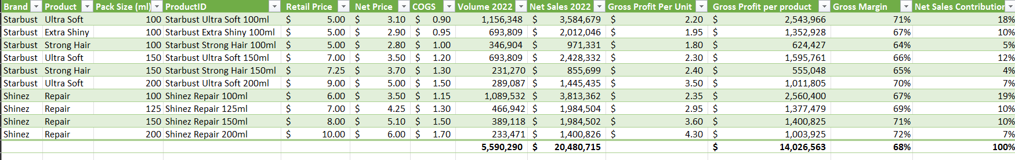
Net sales, Gross Profit, Gross Margin, Net Sales Contribution

Slide 6
Profitability Matrix using Multiple Data Series
Insights
Starbust ultrasoft (150ml +200ml) has a combined profitability of 19%
Even though Shinez repair 100ml alone has a net sales contribution of 19%, its profitability is low.

Slide 7
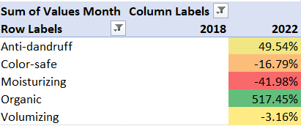
Sales growth from 2018 baseline
The Organic Subcategory can launch a new product based on sales growth
Insights

Slide 8
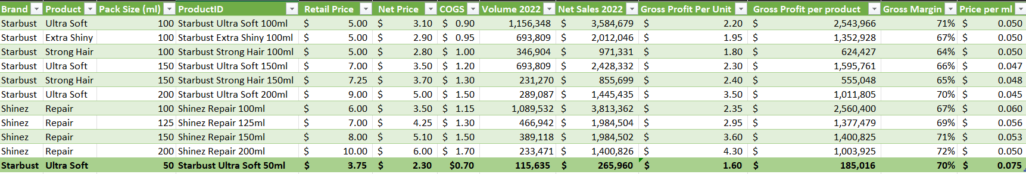
Prick Pack Architecture – New Price strategy for Starbust Ultra Soft 50ml
Insights

Slide 9
Forecast Promotion Analysis
Insights
Buy 2, get 20% off Promotion approach has 12% ROI and it can drive the growth of the business

Slide 10
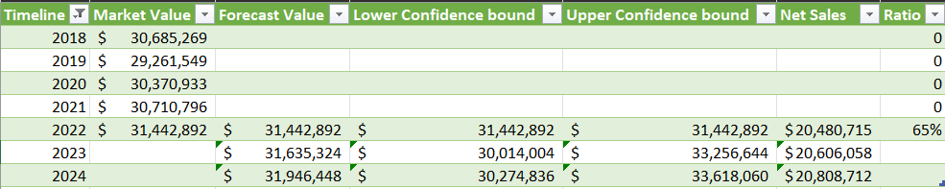
Forecast Net Sales 2024

Slide 11
Thank You

